Slide 1
ELEE 432 Project 1 report
Theo StangeBye and Stephen Lehman

Slide 2
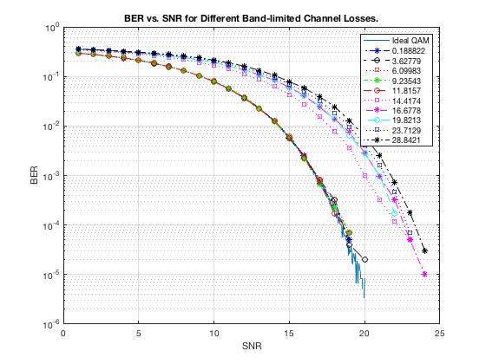
Band-Limited, No distortion
First 5 channels functionally identical to ideal channel
Next 5 significantly worse and get worse as turbidity increases

Slide 3
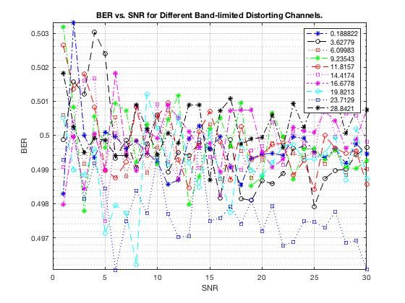
Band-Limited, with distortion, no equalizer
All channels roughly the same
0.5 BER means basically random
Without an equalizer, no data can be sent

Slide 4
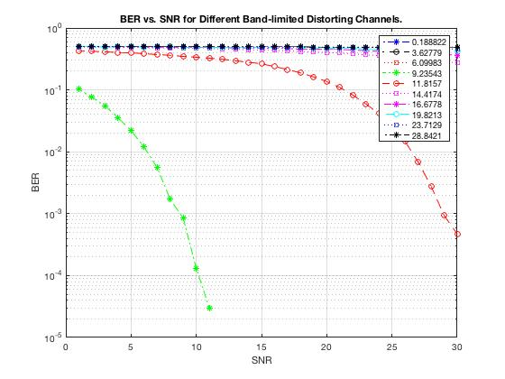
Band-Limited, with distortion, With equalizer
First 3 channels work so well, they don’t show up on the chart
Next channel works better than without distortion
Other channels work worse than without distortion due to band-limiting

